Slide 1
Collaborative Signals Denoising and Augmentation for Recommendation
汇报人：曾永灏
汇报时间：2023.5.18

Slide 2

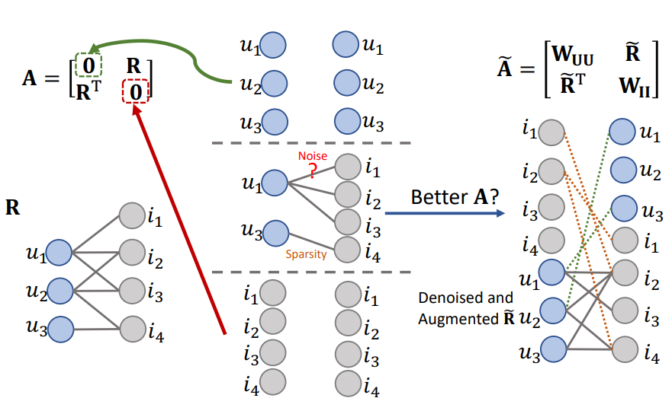
Motivation
受到长尾效应以及噪声的影响，实际的邻接矩阵不足以代表不活跃的用户和物品，并且其并不关注用户-用户和物品-物品的关联性。

Slide 3
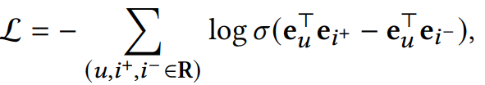
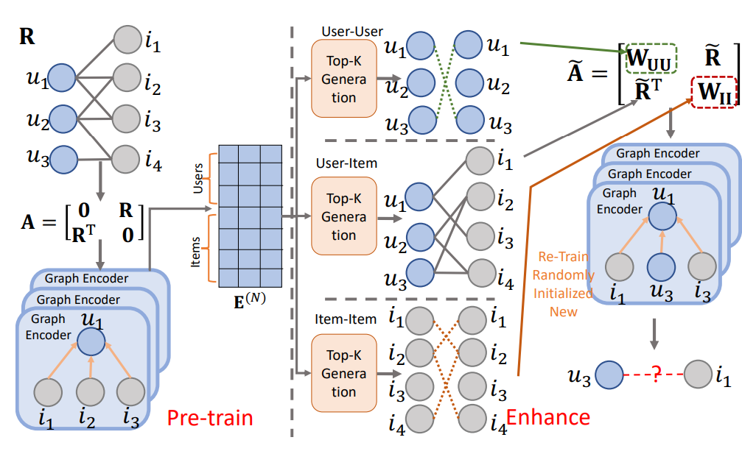
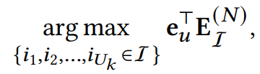

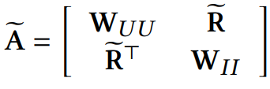
Model
Pre-train:
U-I Enhance:
U-U and I-I Enhance:
Re-learn:

Slide 4
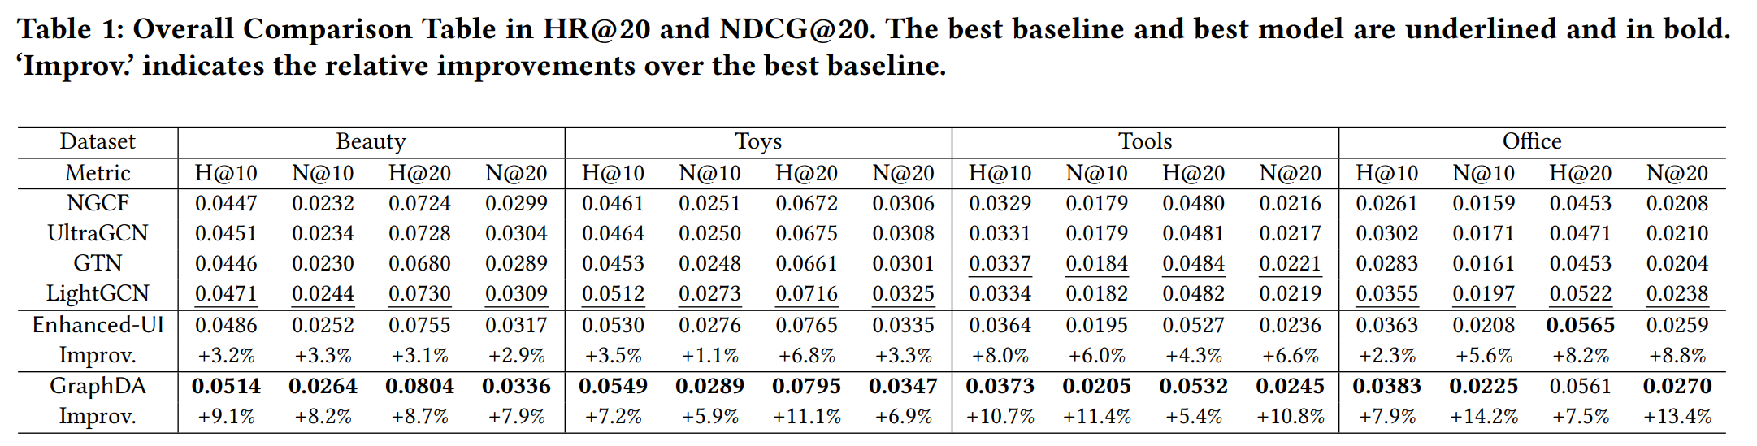
Experiment

Slide 5
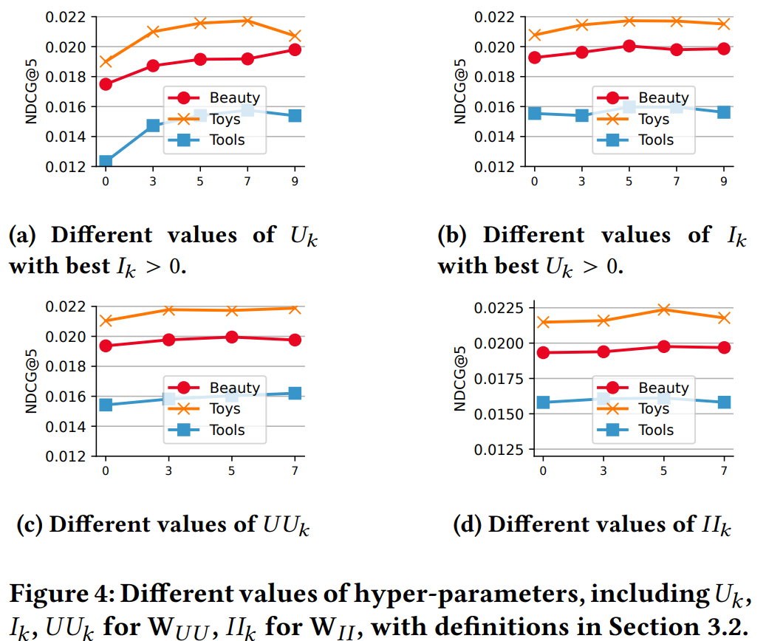
Experiment

Slide 6
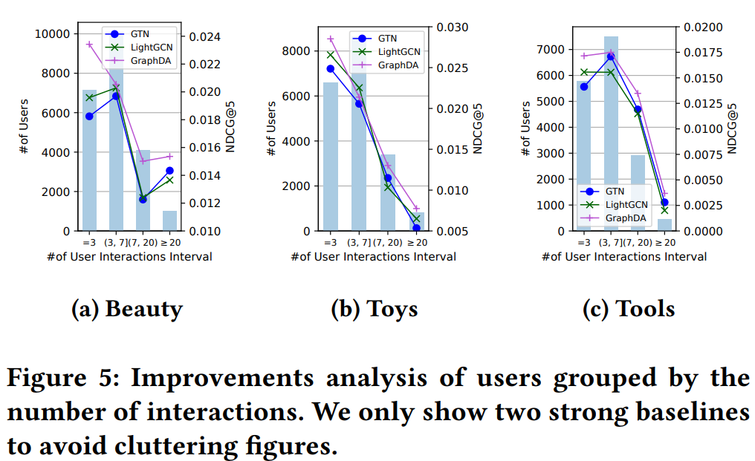
Experiment

Slide 7
Thanks

